Slide 1
MIS FOR SMART WASTE MANAGEMENT SYSTEM M.NITHIN REDDY(192111205) L.BALA KONDAIAH(192111256)

Slide 2
INTRODUCTION
Waste management is a critical issue in urban areas.
Inefficient collection leads to overflowing bins and increased pollution.
An MIS can streamline waste collection through real-time monitoring and optimization.
Real-Time Waste Monitoring – Smart sensors track waste levels, ensuring timely collection and reducing overflow.
Optimized Collection Routes – GPS tracking and data analytics help plan efficient routes, cutting fuel costs and emissions.

Slide 3
ABSTRACT
Management Information System (MIS) for monitoring waste collection schedules, bin capacities, and route optimization.
Provides analytics for efficient resource allocation and cost savings.
Utilizes Cloud Computing, GIS, and DBMS technologies.

Slide 4
SOFTWARE REQUIREMENTS
Cloud Computing for data storage and access.
Geographic Information System (GIS) for route planning.
Database Management System (DBMS) for data storage and retrieval.
Programming languages: Python, Java.

Slide 5
HARDWARE REQUIRMENTS
IoT-enabled smart bins with sensors.
GPS-enabled tracking devices for waste collection vehicles.
Cloud servers for data processing and storage.
Computers and mobile devices for accessing MIS dashboards.

Slide 6
WORKING PROCESS
1. Smart bins collect data on waste levels.
2. Data is transmitted to the cloud.
3. MIS analyzes data and suggests optimized collection routes.
4. Waste collection teams receive real-time updates.
5. Reports are generated for further analysis.

Slide 7
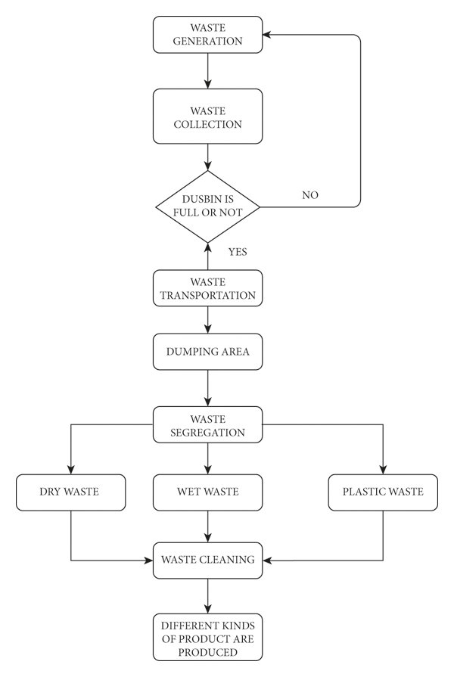
FLOWCHART

Slide 8
Advantages & Disadvantages:
Smart City Integration – Can be combined with other smart city technologies for better urban management.
Real-time monitoring for better decision-making.
High initial implementation cost.
Maintenance and technical expertise needed.

Slide 9
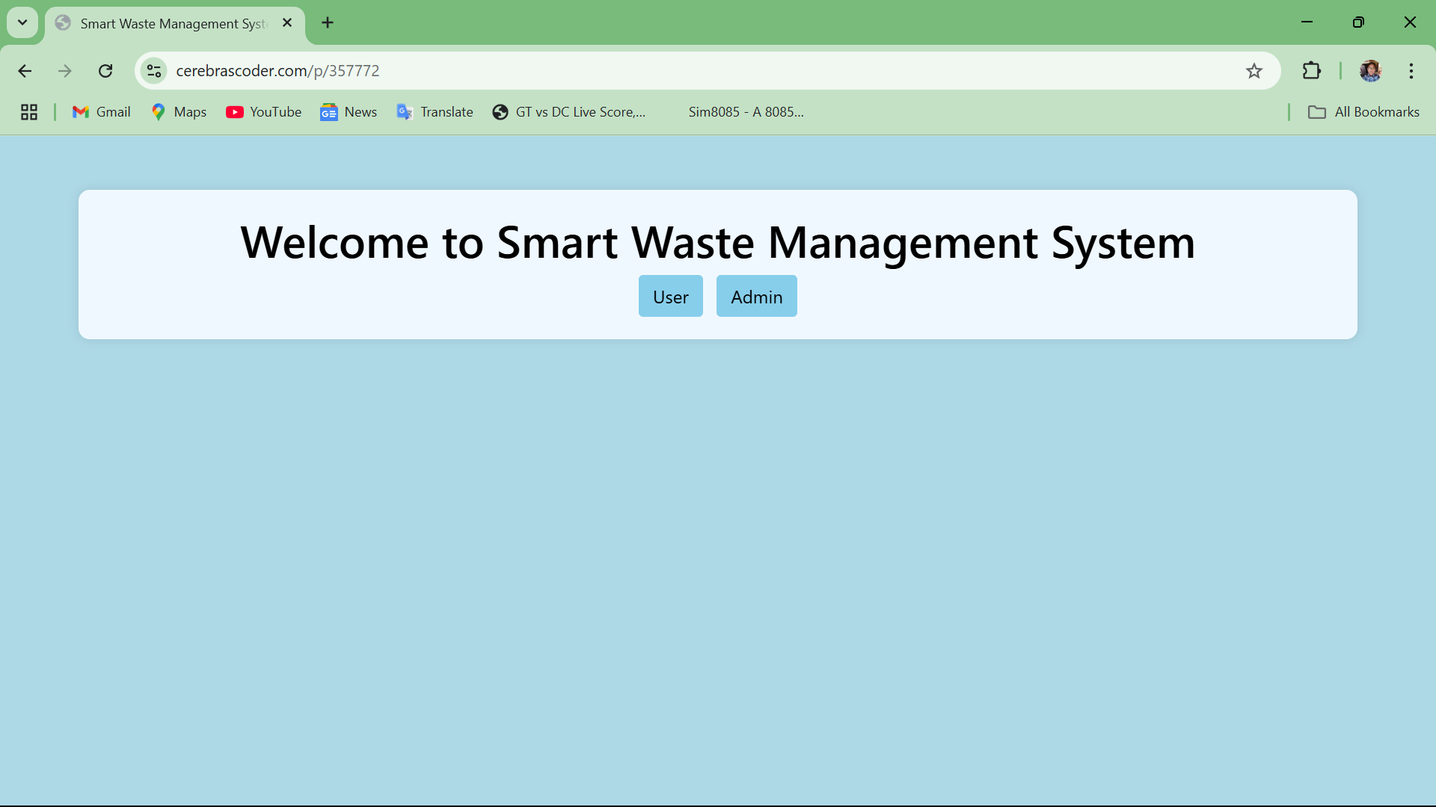
IMPLEMENTATION OUTPUT 1:

Slide 10
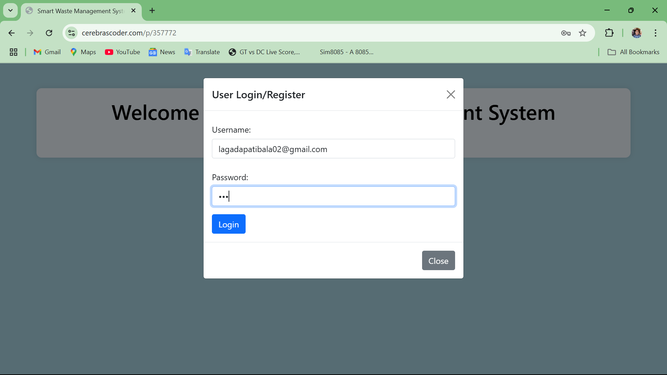
OUTPUT 2:

Slide 11

OUTPUT 3:

Slide 12
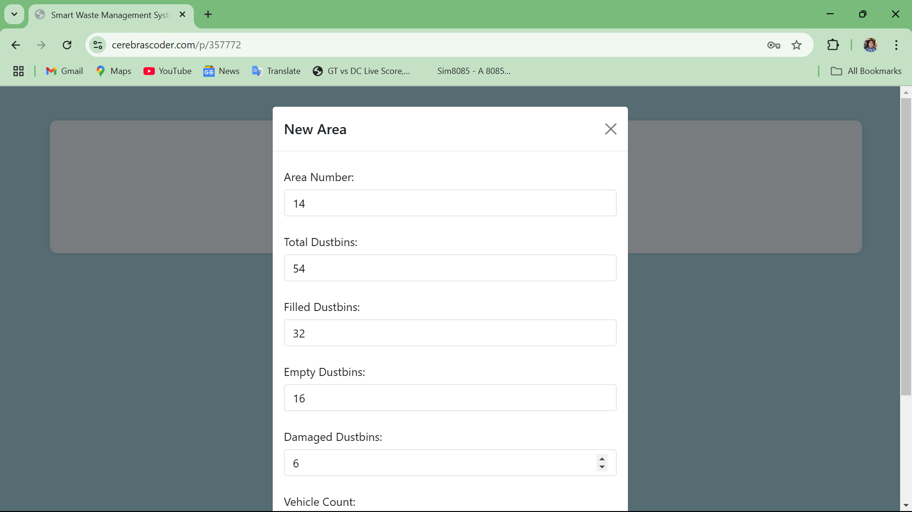
OUTPUT 4:

Slide 13
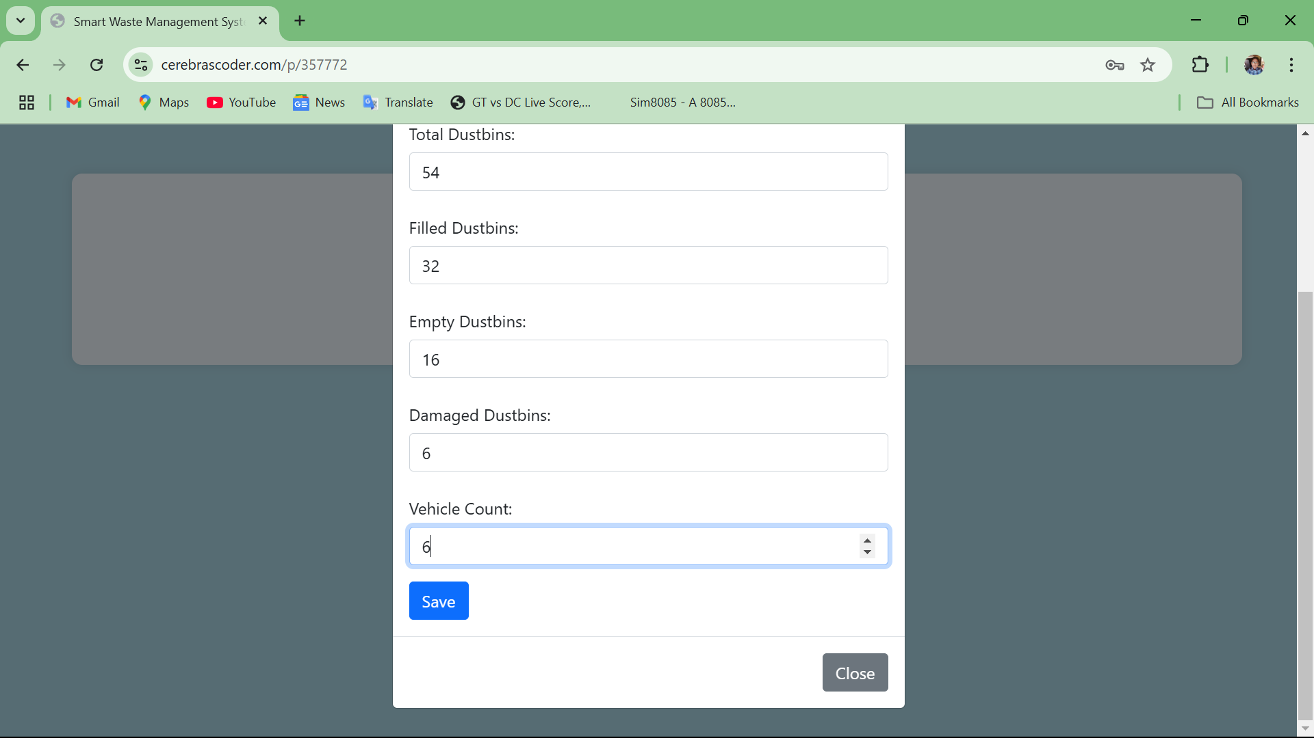
OUTPUT 5:

Slide 14
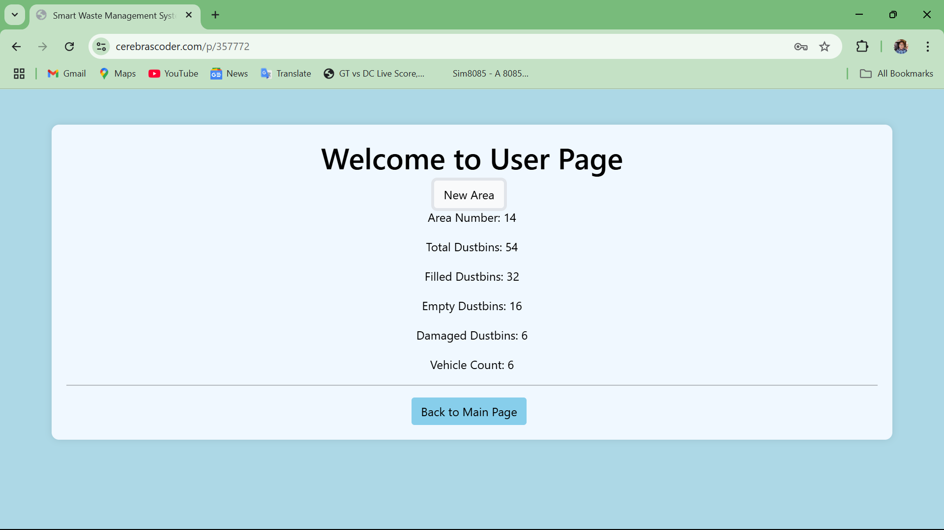
OUTPUT 6:

Slide 15
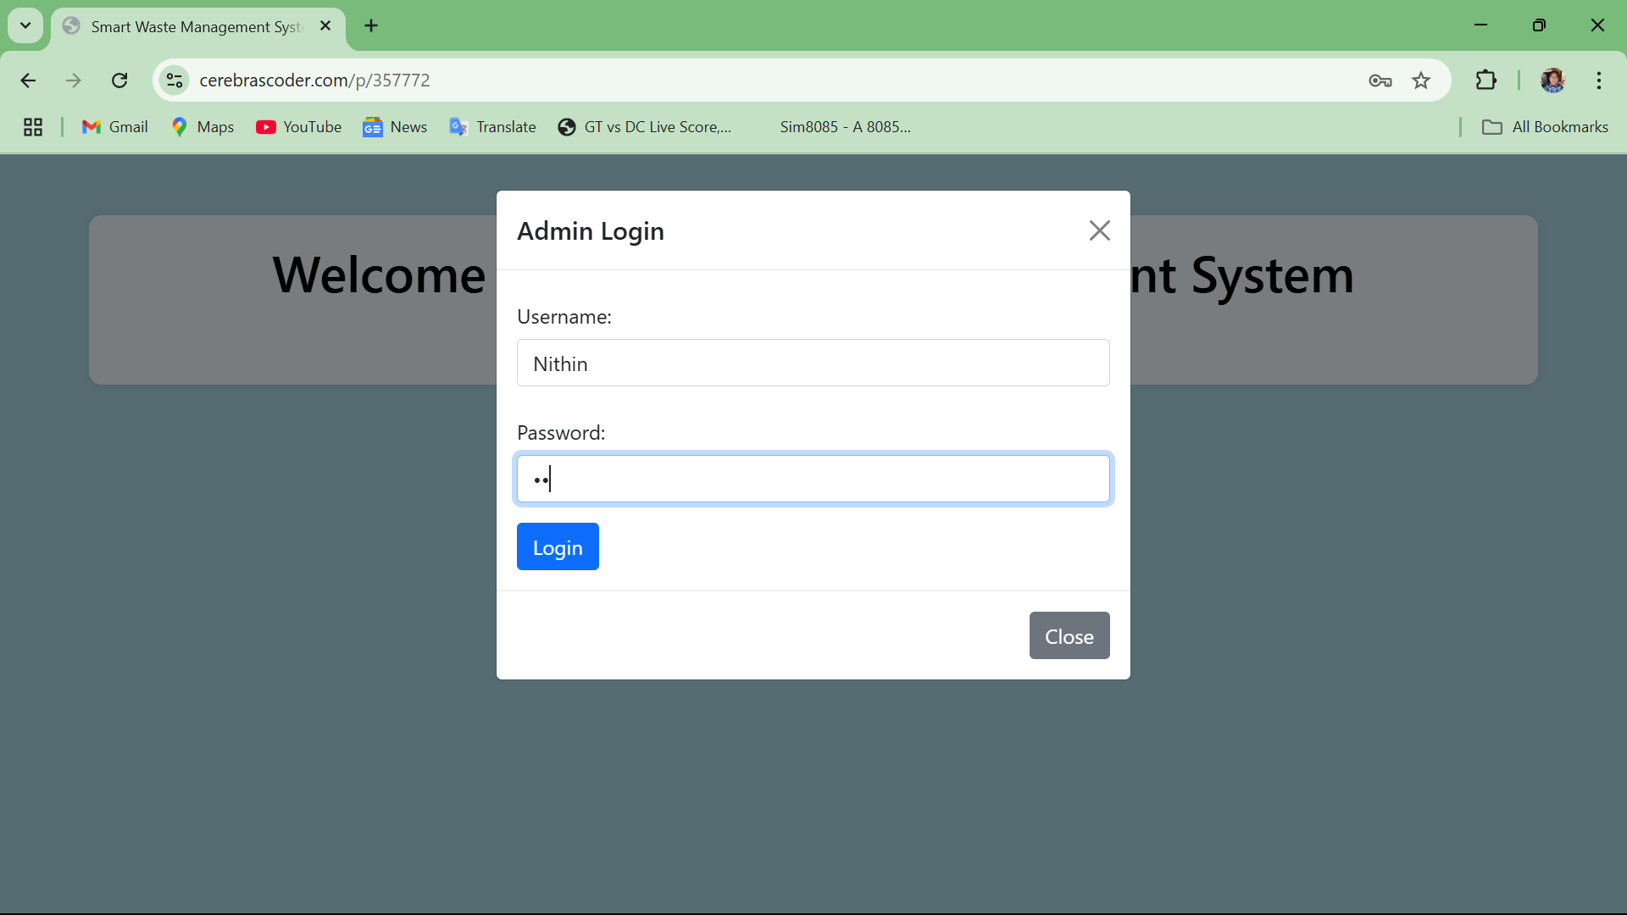
OUTPUT 7:

Slide 16
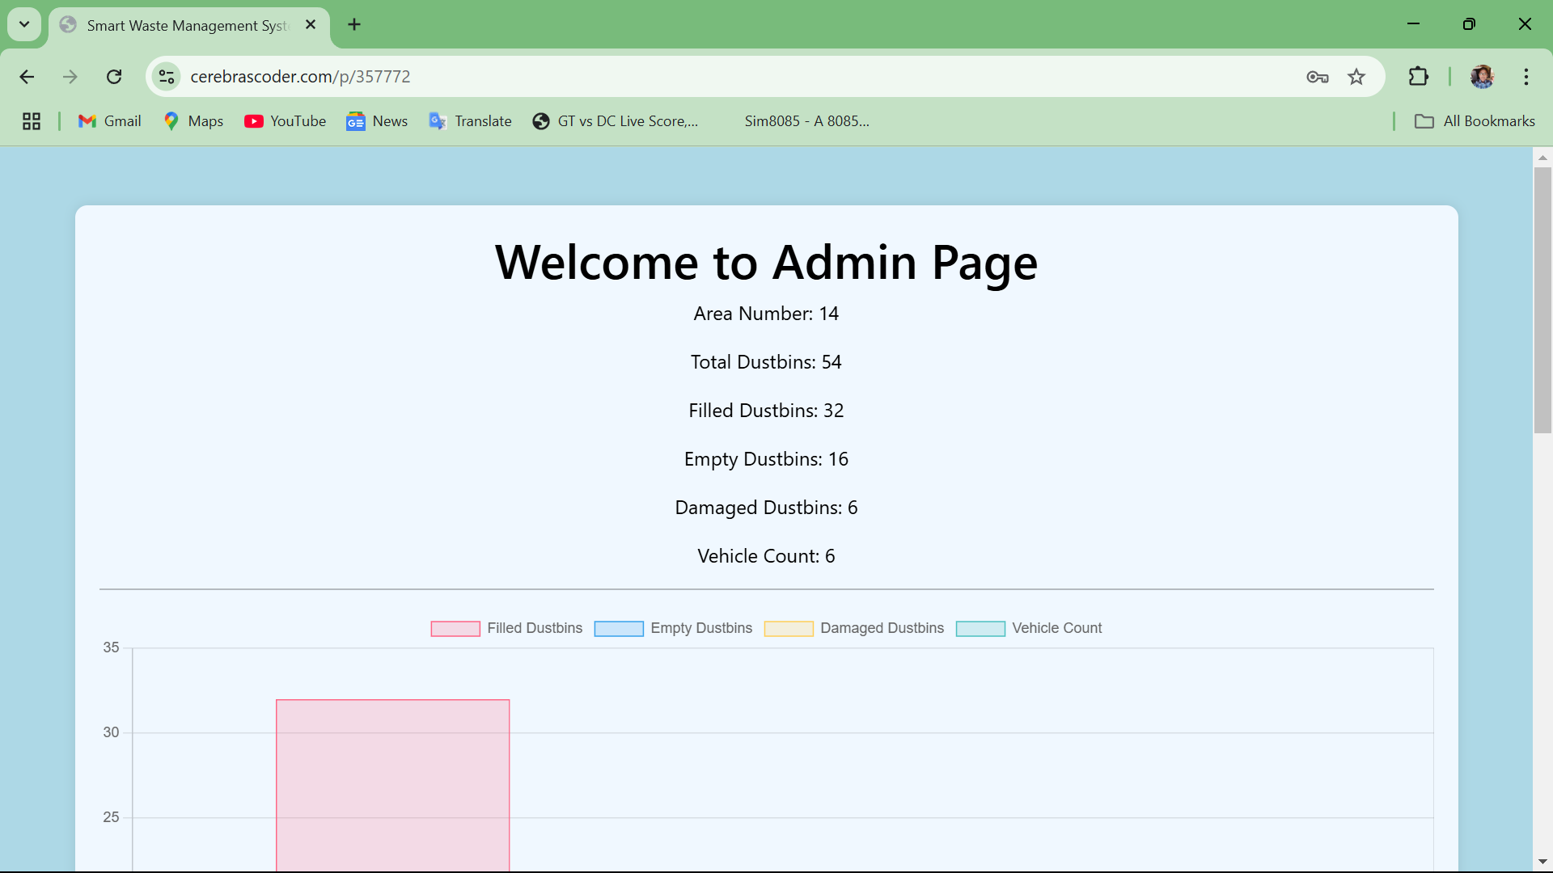
OUTPUT 8:

Slide 17
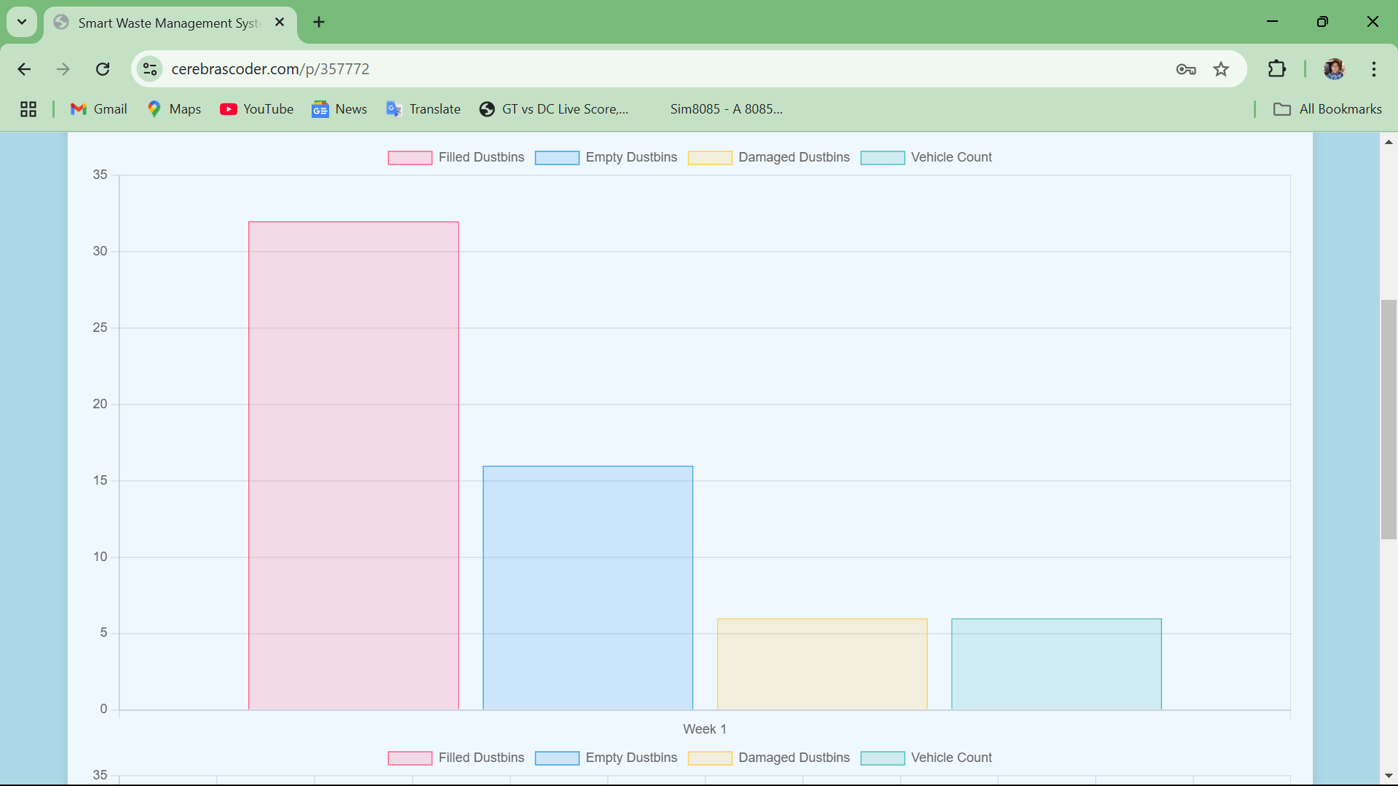
OUTPUT 9:

Slide 18
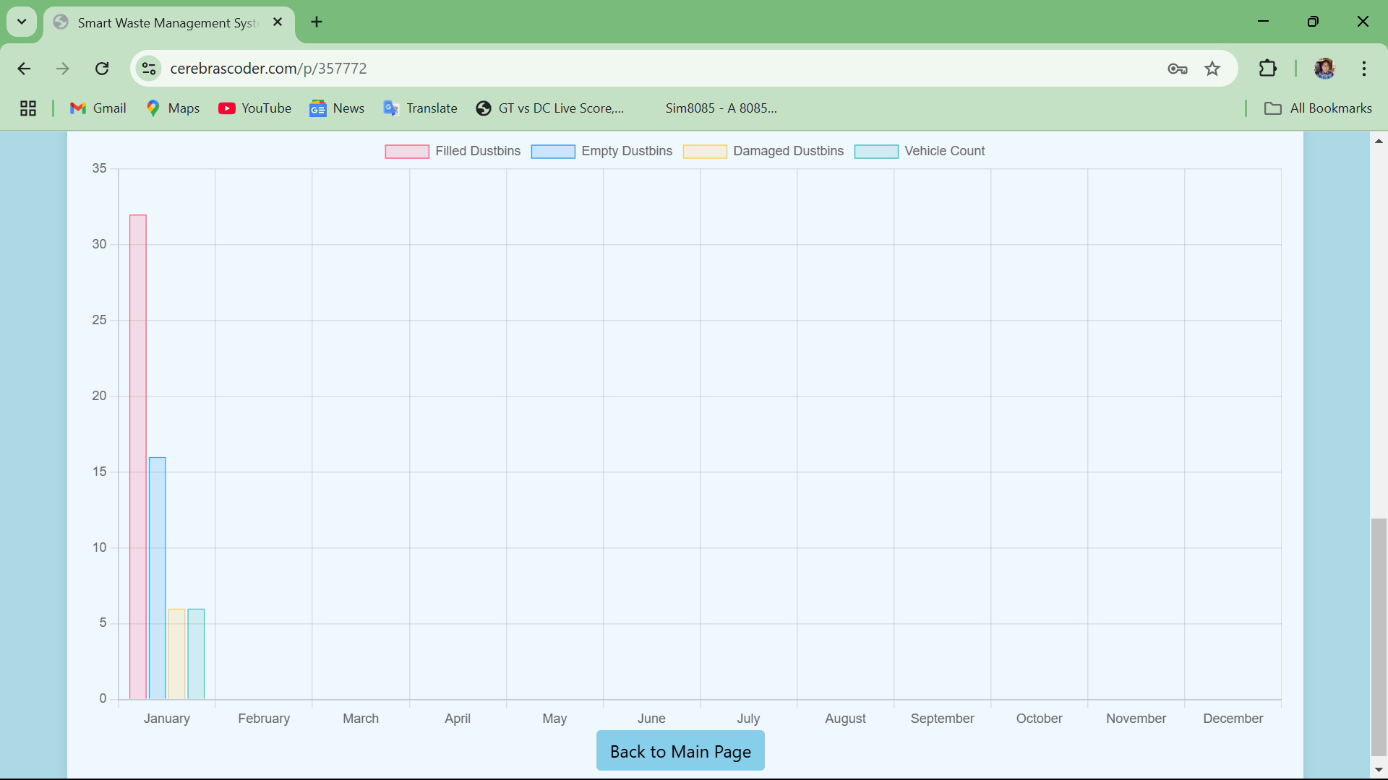
OUTPUT 10:

Slide 19
Role of DBMS in Analytics
Data Storage & Management – Organizes and stores data from waste bins, sensors, and collection schedules for efficient retrieval.
Real-time Processing & Analytics – Analyzes bin capacity, waste accumulation trends, and predicts optimal collection times.
Route Optimization – Uses GIS data to determine the most efficient collection routes, reducing fuel costs and improving efficiency.
Security & Scalability – Ensures data integrity, access control, and supports large-scale waste management operations.

Slide 20
Conclusions
A Database Management System (DBMS) is essential for managing and analyzing data in a Smart Waste Management MIS. It efficiently stores and organizes data from waste bins, sensors, and collection schedules, ensuring real-time retrieval and analysis. By leveraging predictive analytics, it helps forecast waste accumulation trends, enabling proactive planning for waste collection and resource allocation.

Slide 21
THANK YOU

